Slide 2
Responsible AI
Preet Kanwal
Unit 2 : Lecture 4: Fairness in Machine Learning - Overview

Slide 3





Machine Learning Pipeline
Data
Algorithm
Model

Slide 4


Slide 5
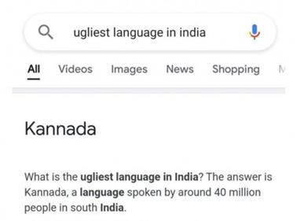
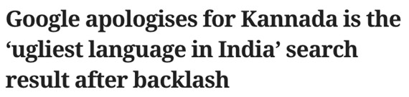
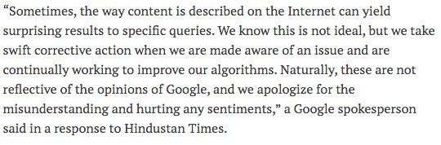

Slide 6

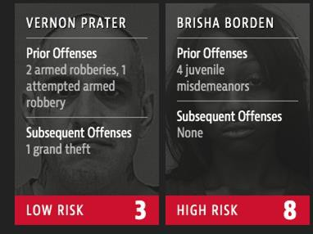
COMPAS SYSTEM
Source: https://www.propublica.org/article/machine-bias-risk-assessments-in-criminal-sentencing

Slide 7
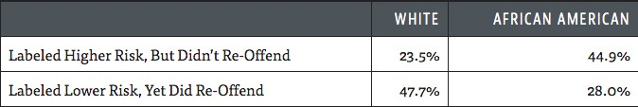
STATS from COMPAS
Source: https://www.propublica.org/article/machine-bias-risk-assessments-in-criminal-sentencing

Slide 8

Amazon scraps secret Al recruiting tool that showed bias against women

Slide 9
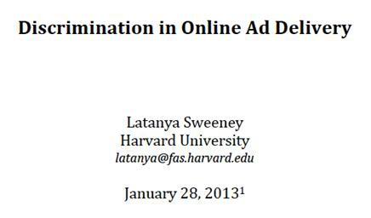
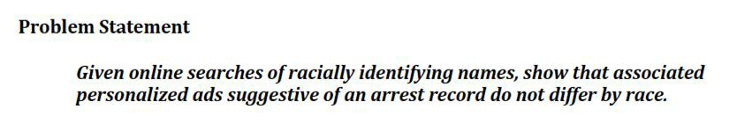
https://papers.ssrn.com/sol3/papers.cfm?abstract_id=2208240

Slide 10
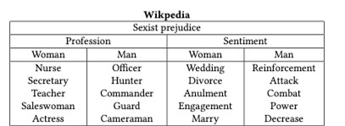
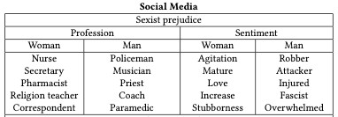
Biases in Word Embeddings
https://blog.acolyer.org/2020/12/08/bias-in-word-embeddings/

Slide 11
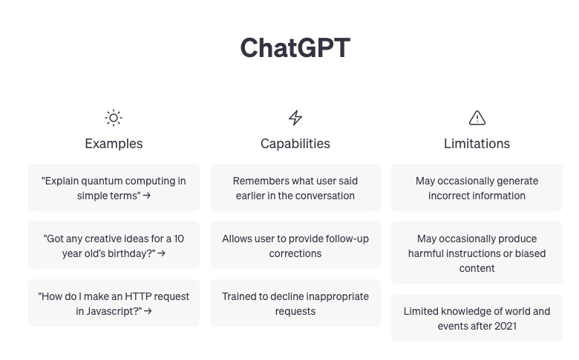

Slide 12
How do we fix it?
But first, what exactly is fairness?
One practical approach researchers often take is this: let’s treat fairness as “whatever is legal.”

Slide 13
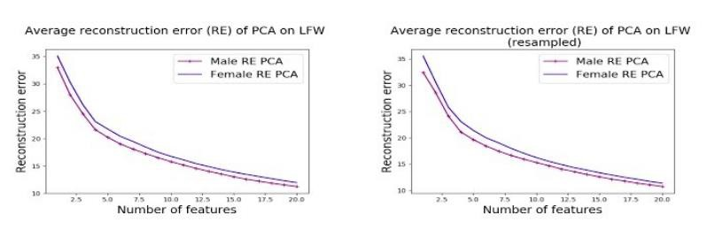
Fair unsupervised learning
UnFair PCA
https://sites.google.com/site/ssamadi/home/fair-pca-homepage

Slide 14
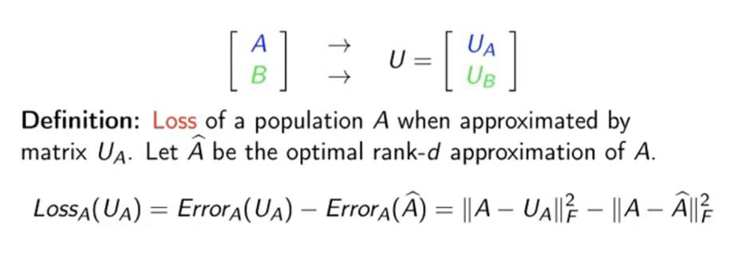
UnFair PCA
https://sites.google.com/site/ssamadi/home/fair-pca-homepage

Slide 15
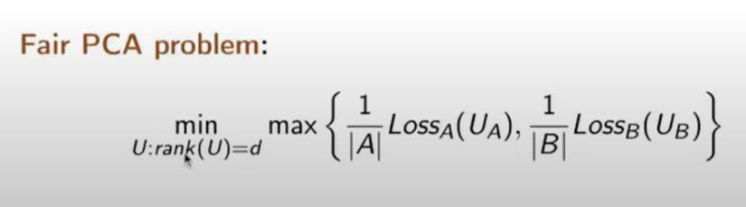
UnFair PCA

Slide 16
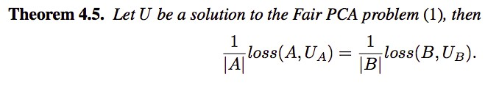
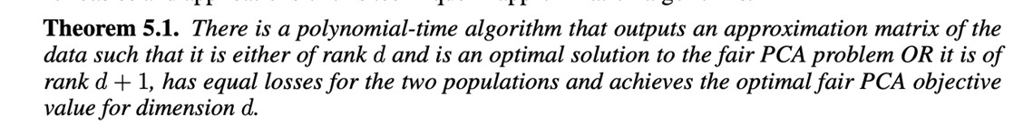
https://sites.google.com/site/ssamadi/home/fair-pca-homepage

Slide 17
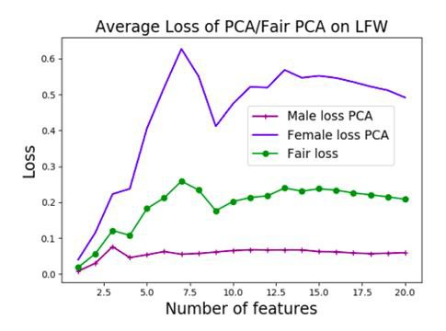
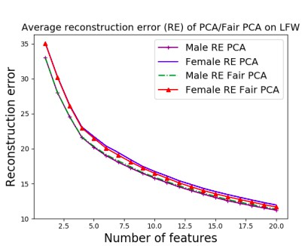

Slide 18
Fair Supervised learning

Slide 19
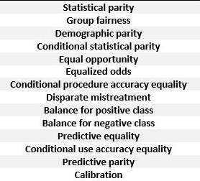
No single answer

Slide 20
Statistical Parity
X – set of all data points (people)
C – Set of all data points (people) belonging to a certain protected group
M: X -> {0,1} - a classifier, say logistic regression
Bias of classifier for the protected group:
Parity(M,C) = Pr(M(x) = 1 | x in C) - Pr(M(x) = 1)
Ideal classifier => Parity = 0
In practice, min |parity(M,C)}

Slide 21
Equality of Opportunity
X – set of all data points (people)
C – Set of all data points (people) belonging to a certain protected group
M: X -> {0,1} - a classifier, say logistic regression
opportunity_inequality(M,C) = Pr(M(x) = 1| y=1 and x ∊ C) - Pr(M(x) = 1|y=1)
Ideal classifier: opportunity_inequality = 0
In practice: min |opp_ineq(M,C)|

Slide 22
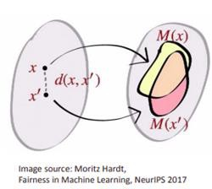
Individual Fairness
X – set of all data points (people)
M X -> Δ (simplex) - a classifier, say logistic regression. d: X * X -> R - distance function
D: Δ * Δ -> R – distance between probability vectors
D(M(x),M(x’)) <= d(x,x;’) for any x.x’

Slide 23
Outcome Test (Predictive Parity)
X – set of all data points (people)
C – Set of all data points (people) belonging to a certain protected group
M: X -> {0,1} - a classifier, say logistic regression.
Pred_parity(M,C) = Pr(y=1| M(x) = 1 and C) - Pr(y=1| M(x) = 1)
Ideal classifier: Pred_parity = 0
In practice: min |Pred_parity(M,C)|

Slide 24
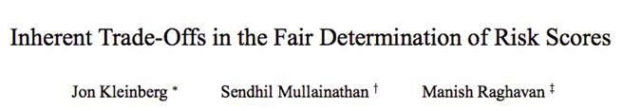
Impossiblity Result
Opportunity_inequality(M,C) = Pr(M(x) = 1| y=1 and C) - Pr(M(x) = 1|y=1)
Calibration within groups – Pr(M(x) = 1| x in C) ~= Pr(y=1| x in C)

Slide 25


Fair Logistic Regression
Parity = |Pr(M(x) = 1|C = 1 ) - Pr(M(x) = 1| C= 0 )|
Regularized logistic loss on dataset
Measures how correlated
are the prediction probabilities to the Protected attribute.
Protected attribute for data point i
https://dl.acm.org/doi/fullHtml/10.1145/3308560.3317584

Slide 26
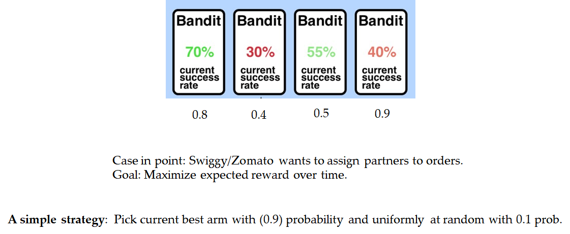
Fair Multi Armed Bandits

Slide 27
Fair Multi Armed Bandits
Notion of Fairness:
If partner-a is truly better than partner b, then
Probability that algorithm assigns partner a >= Probability that algorithm assigns partner b
A simple strategy: Pick current best arm with (0.9) probability and uniformly at random with 0.1 prob.

Slide 28
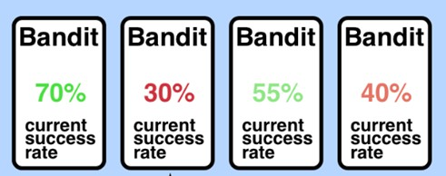
0.6
0.5
0.5
0.35
0.6
0.38
0.4
0.3
IDEA: Sample uniformly from those whose confidence interval overlaps with the winner

Slide 29
Fair PCA
Fair LogReg
Fair MAB

Slide 30

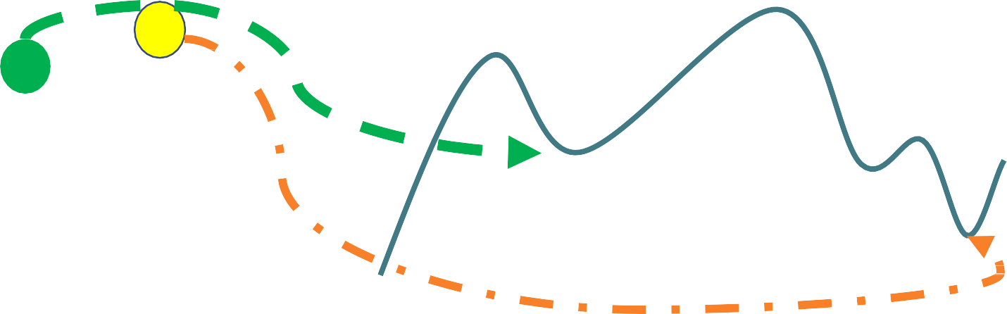
Original Loss function
`
Fairness constraint space
Perturbed Loss function

Slide 31

Model

